Slide 1






HOUSEHOLD ENERGY CONSUMPTION ANALYTICS
ALY6110 DATA MANAGEMENT AND BIG DATA
CRN: 72145
Done By
Anish Nitin Somaiah, NUID: 001894328, somaiah.a@husky.neu.edu
Vignesh Thulasi Dass, NUID: 001385745, thulasidass.v@husky.neu.edu
Aditi Mayurkumar Patel, NUID: 001893349, patel.adit@husky.neu.edu
Shubhi Singal, NUID: 001359286, singal.shu@husky.neu.edu
Instructor: Mr. Valeriy Shevchenko

Slide 2


THE PROBLEM ASSOCIATED
For Energy industries, the problem associated for Producers is to identify whether they are supplying for demand and generating ROI in a sustainable and profitable way.
For Energy consumers, the problem associated with consumers is to maintain optimal usage of supplied energy to avoid higher bills.

Slide 3
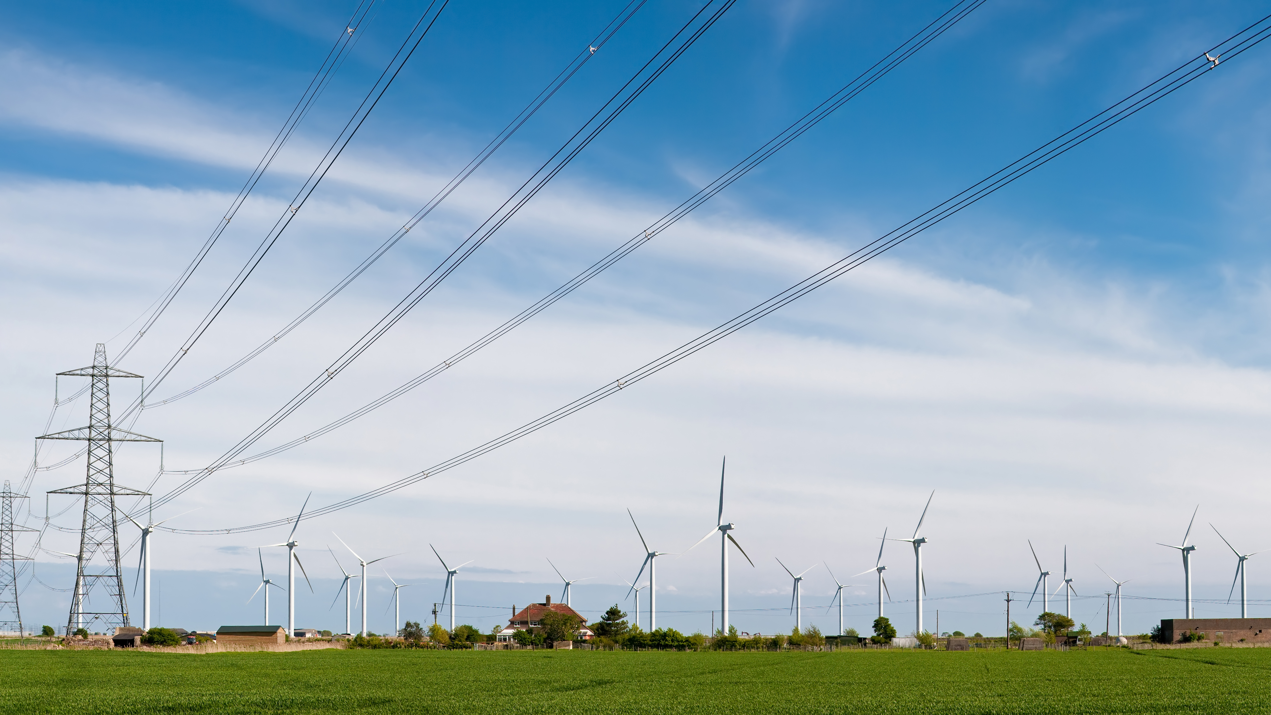
THE OBJECTIVE (SOLUTION METHODOLOGY)
To analyze the amount of energy consumed in a household which is given to us as a timeseries and derive patterns from the obtained real time data.
To produce and supply based on customer needs during specific time periods to avoid wastage.
To understand consumer’s own household’s energy patterns which will eventually help towards energy conservation and bill reduction.

Slide 4
DATA DICTIONARY
Dataset Source:
http://archive.ics.uci.edu/ml/datasets/Individual+household+electric+power+consumption
Dataset Description:
This archive contains 2075259 measurements gathered in a house located in Sochaux (7km of Paris, France) between December 2006 and November 2010 (47 months) and 9 features as mentioned below.
date: Date in format dd/mm/yyyy
time: time in format hh:mm:ss
global_active_power: household global minute-averaged active power (in kilowatt). Used by low load devices such as bulbs, fans etc.
global_reactive_power: household global minute-averaged reactive power (in kilowatt). Surplus power not used at the time period.
voltage: minute-averaged voltage (in volt)
global_intensity: household global minute-averaged current intensity (in ampere)
sub_metering_1: energy sub-metering No. 1 (in watt-hour of active energy). It corresponds to the kitchen, containing mainly a dishwasher, an oven and a microwave (hot plates are not electric but gas powered).
sub_metering_2: energy sub-metering No. 2 (in watt-hour of active energy). It corresponds to the laundry room, containing a washing-machine, a tumble-drier, a refrigerator and a light.
sub_metering_3: energy sub-metering No. 3 (in watt-hour of active energy). It corresponds to an electric water-heater and an air-conditioner.

Slide 5


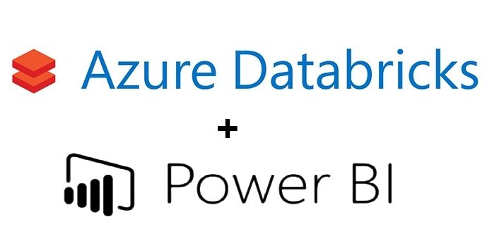
DATA PROCESS WORKFLOW
Input Data
Understand data
Relational Tables using queries
Setup Clusters
Data analytics was implemented using databricks Azure as Apache Spark is faster than MapReduce and it performs in memory computations.
PySpark tool is used to clean data if necessary and check cluster status and input our data as RDD to perform operations.
Spark SQL is used to create Relational data tables using Queries to derive business intelligence.
Power BI integrated into Databricks Azure to understand relational tables through plots.
Business Intelligence

Slide 6
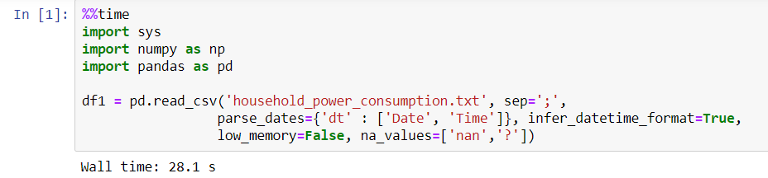
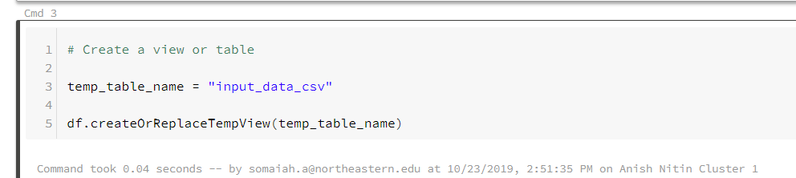
WHY BIG DATA SYSTEM?

Slide 7
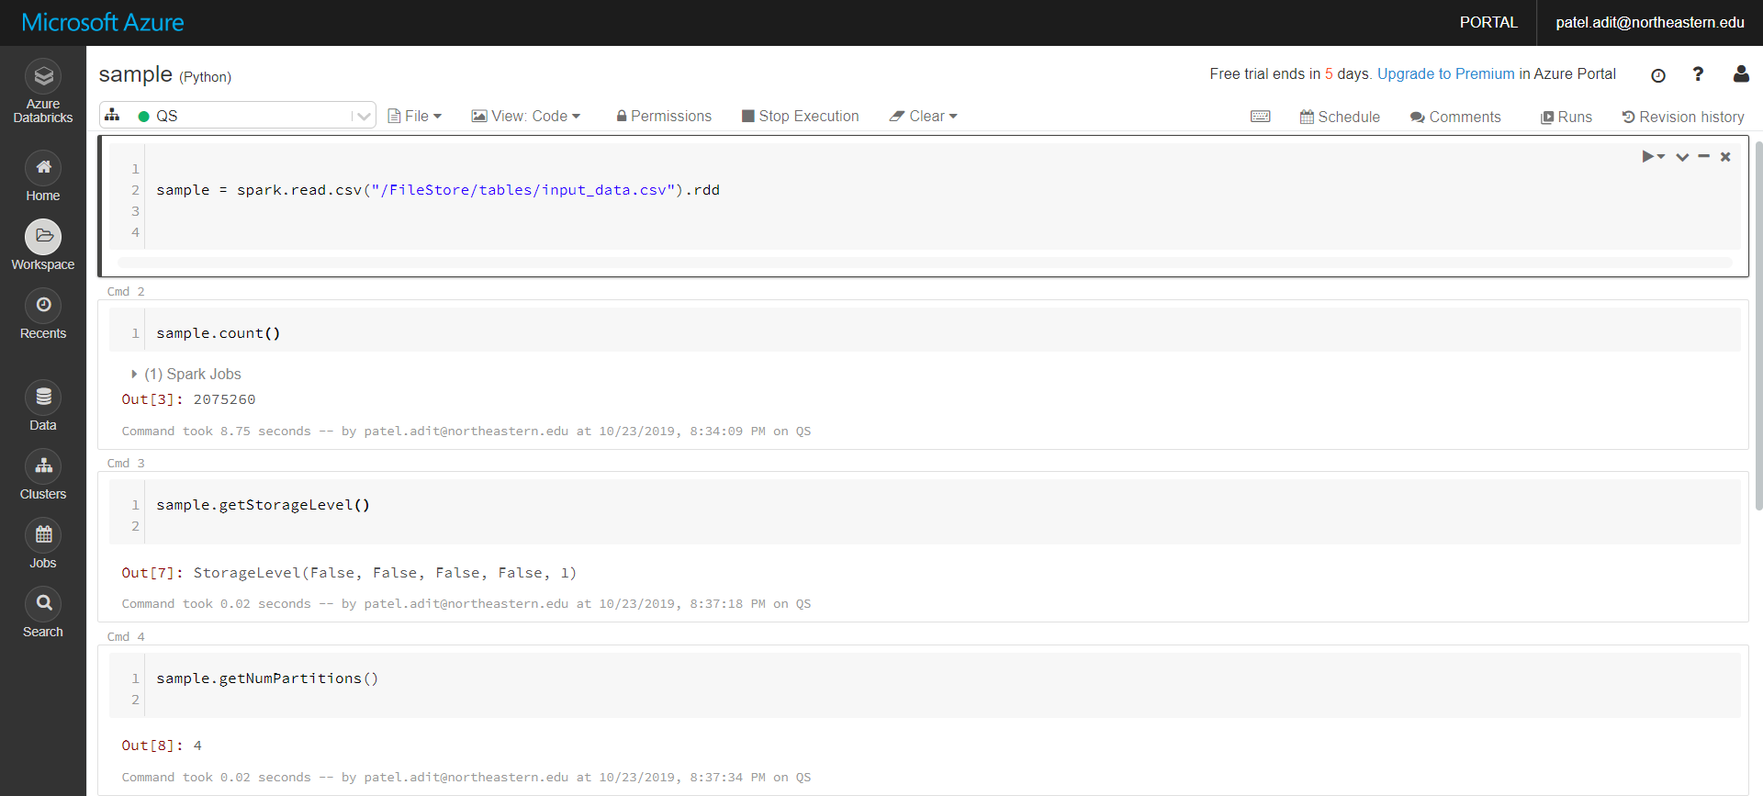
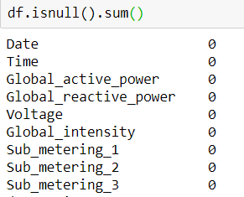
DATA MANAGEMENT : PYSPARK
USED PYSPARK RDD FUNCTIONS TO UNDERSTAND NATURE OF DATA SET, CLUSTER AND CHECK FOR NULL VALUES IN THE DATASET.

Slide 8
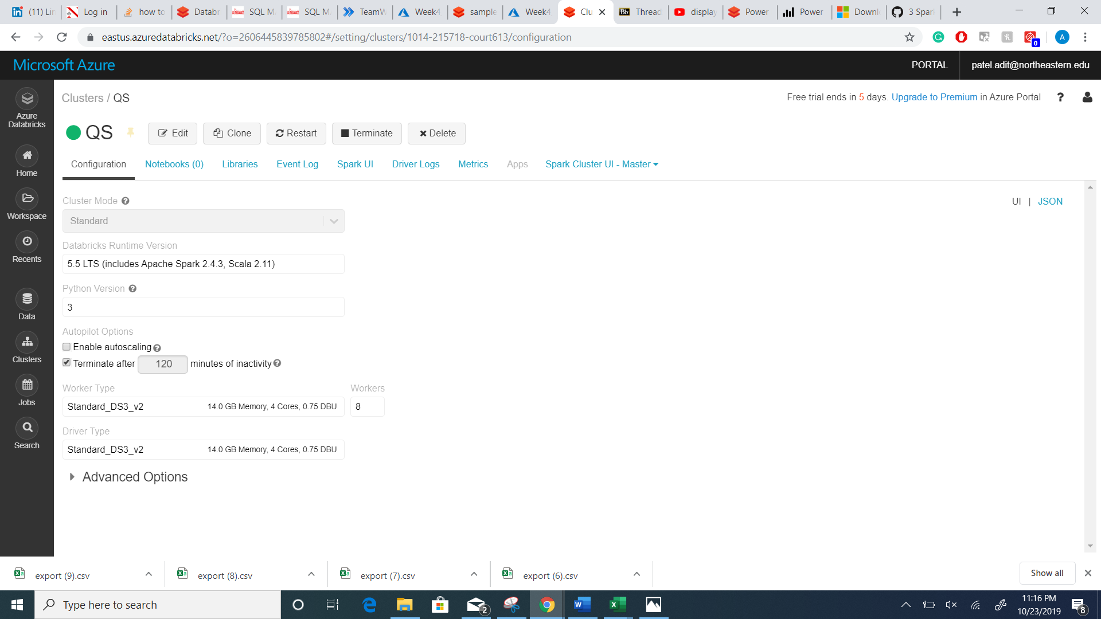
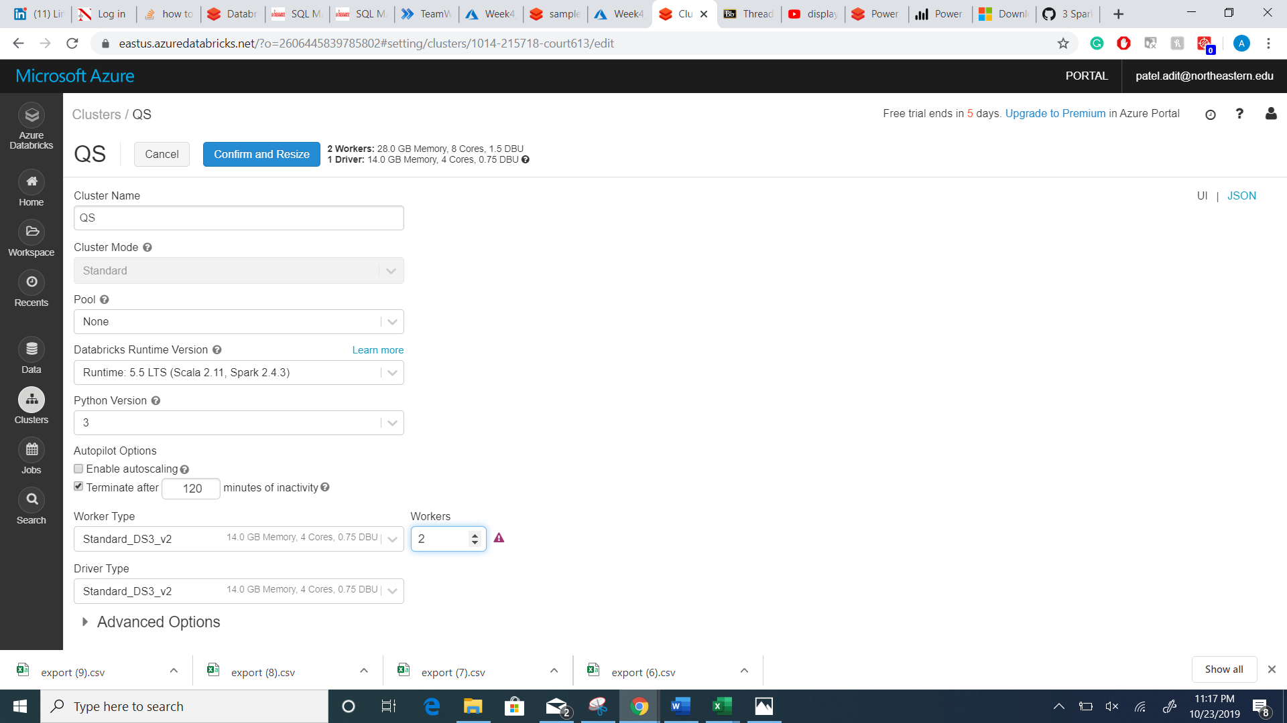
CLUSTER MANAGEMENT

Slide 9
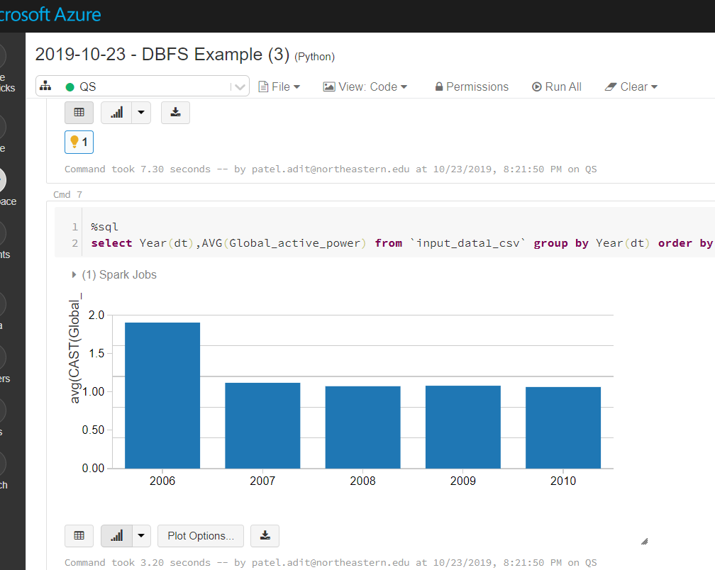
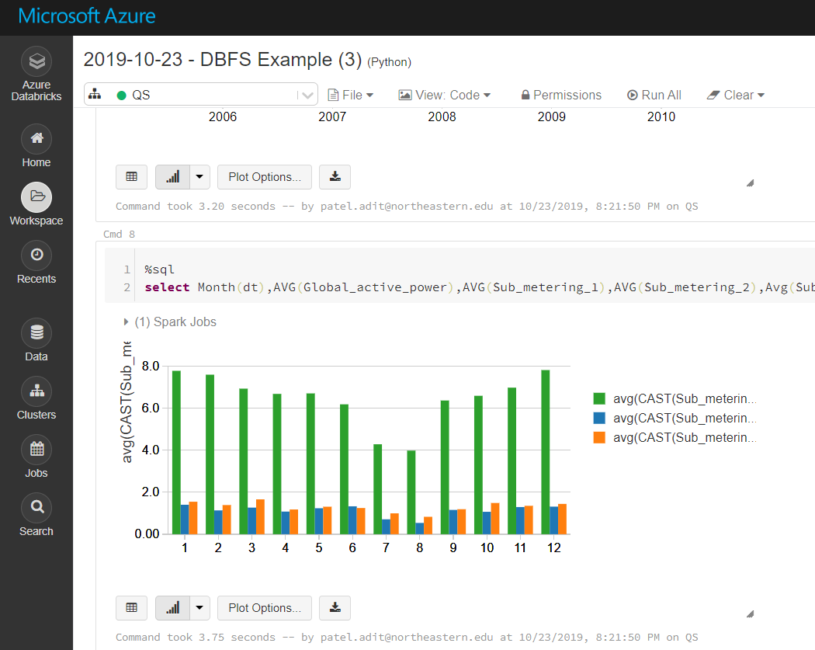
RELATIONAL TABLES : QUERYING USING SPARK SQL

Slide 10
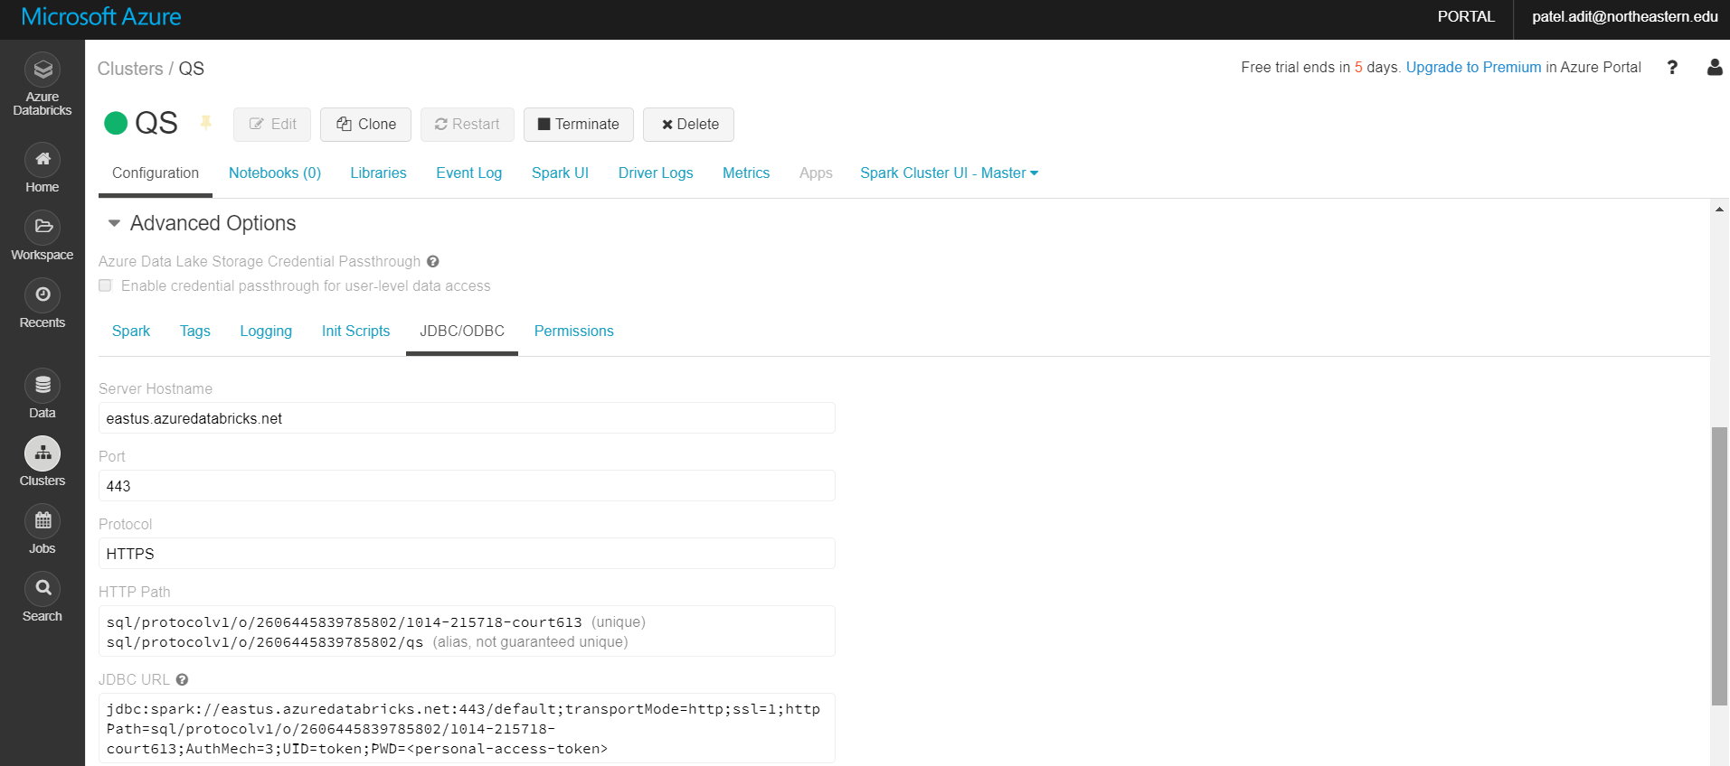
INTEGRATING QUERY DBMS TO POWER BI USING JDBC LINK

Slide 11
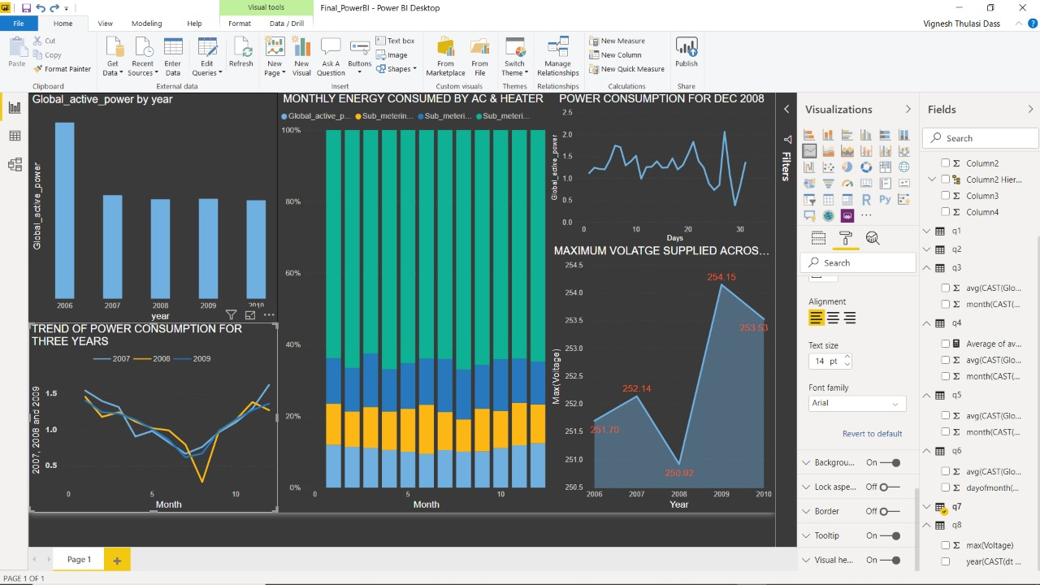
POWER BI DASHBOARD

Slide 12
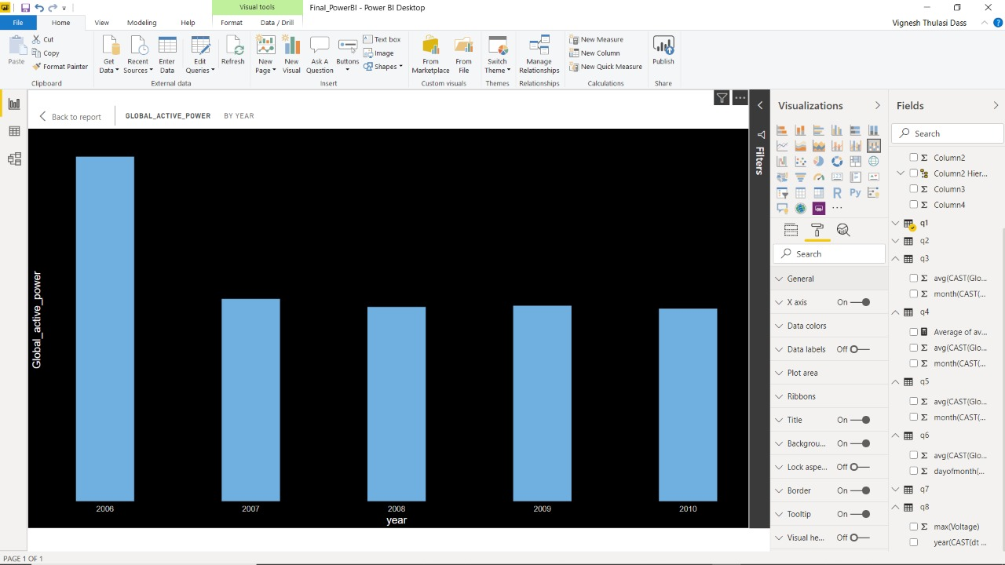
YEARLY TREND OF ACTIVE POWER CONSUMPTION
Yearly Trend of Active power consumption shows that the average power consumed remained the same throughout the years
Hence a distributor has no necessity to increase supply.

Slide 13
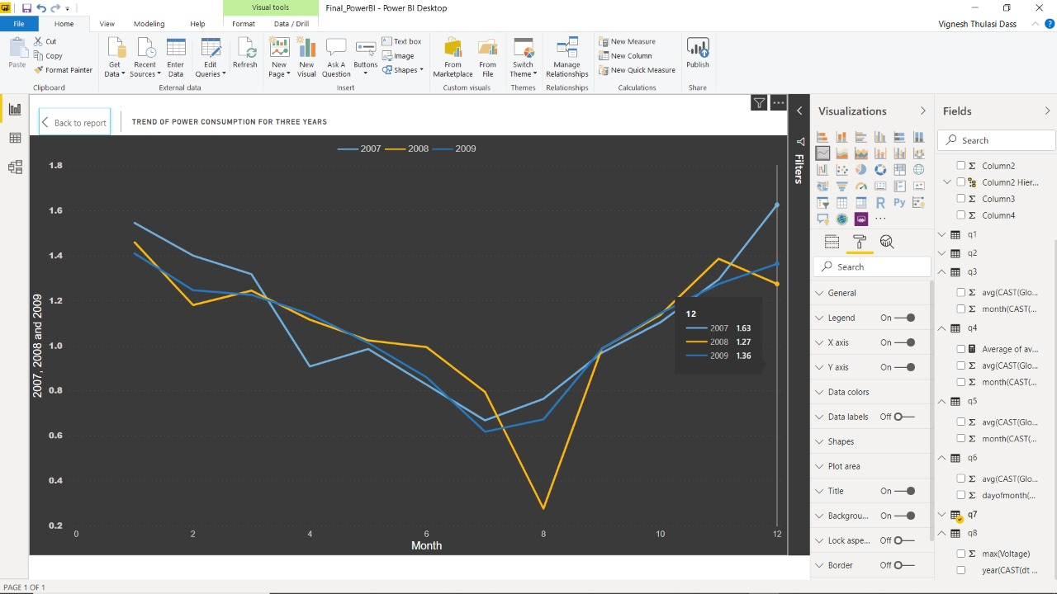
MONTHLY TREND OF POWER CONSUMPTION
As we can see from the trend we have active power consumption mildly decreasing in summer months and sharply increasing in winter months.
This is because during summer days low load consumption is less as daylight is more and later when winter starts, low load consumption increases.

Slide 14
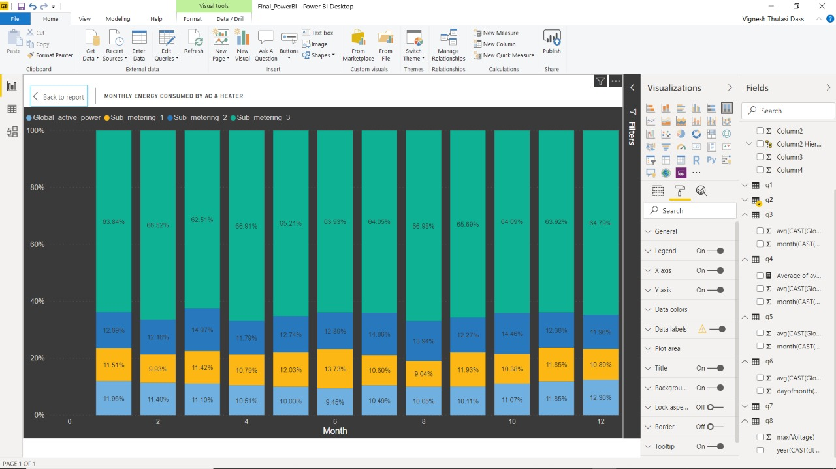
POWER CONSUMPTION DISTRIBUTION ANALYSIS
This Distribution analysis clearly tells that throughout in the year, highest electricity reading is observed in the meter designated to ac and water heaters.

Slide 15
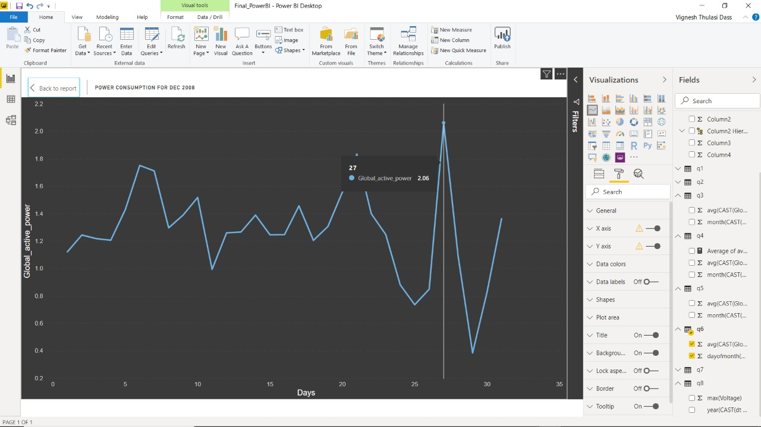
DAILY ANALYTICS PER MONTH
A specific month’s consumption data has been selected using SQL query.
It was observed that there are regular spikes in consumptions during weekends.

Slide 16
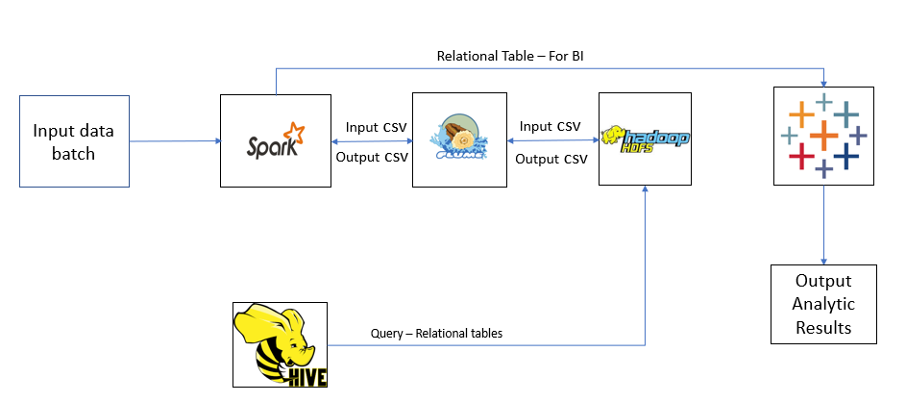
FUTURE SCOPE
Tune a big data system to obtain real time data and perform time series forecasting based on trend and seasonality.
Perform Machine Learning Clustering Model for the given data set using SPARKML to identify clusters based on usage patterns which can be used to segregate supply based on the clusters.
The scope of this project can be extended not only to electricity generators but also to power plants which produce energy through different sources such as crude oil, wind, water and renewable resources. This can help in sustainable usage of non-renewable energy sources which can be made everlasting and accessible for a longer period of time for any energy production and consumption unit.

Slide 17


Slide 18

REFERENCES
Azure Databricks Quickstart (October 2019), Documentation Retrieved from, https://docs.azuredatabricks.net/getting-started/quick-start.html
Azure Blob Storage (October 2019), Documentation Retrieved from, https://docs.databricks.com/data/data-sources/azure/azure-storage.html
Epydoc(November 2014), RDD Functions in Spark, Documentation Retrieved from, https://spark.apache.org/docs/1.1.1/api/python/pyspark.rdd.RDD-class.html
Joshua Daniel Rhodes (May 2014), Optimal residential energy consumption, prediction, and analysis, Retrieved from, https://repositories.lib.utexas.edu/handle/2152/33342

